Slide 1


Motodynamics
Hackathon Phase 1
MSc In Statistics
Data Analysis
Marina NIKOLAIDOU

Slide 2
Topics
Discuss the analysis findings information from the given dataset
Describe a general costumer profile
Explore the response (On Desk Net Revenue) variable
Modeling (predict the Total Revenue)
Conclusions

Slide 3
Most Frequent Car features
EDMR
AUDI
MDMR
FIAT
OPEL
White
BLACK
GREY

Slide 4

Incremental
The incrementals the costumers prefer the most are:
LD - Loss Damage Waiver
BF -Loss Damage Waiver minimum
TG -Tyre and Windscreen Coverage
AD –Additional Driver

Slide 5

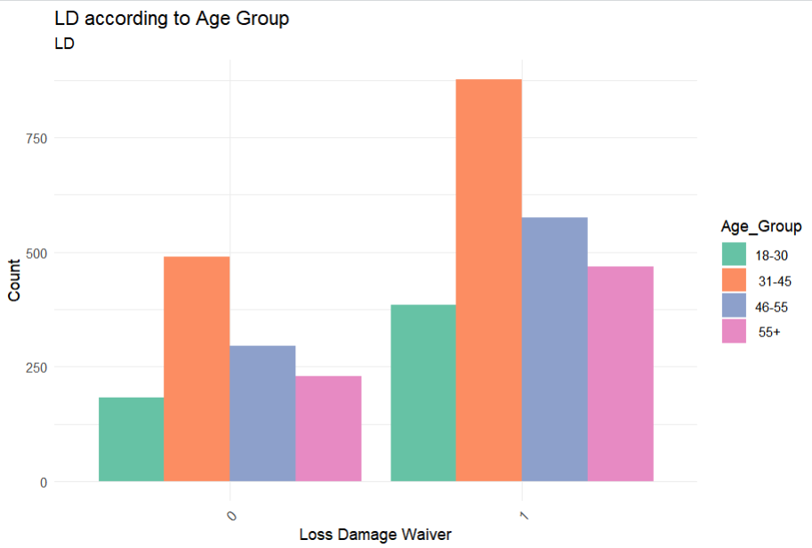



LD is the only incremental that the most costumers purchase

Slide 6
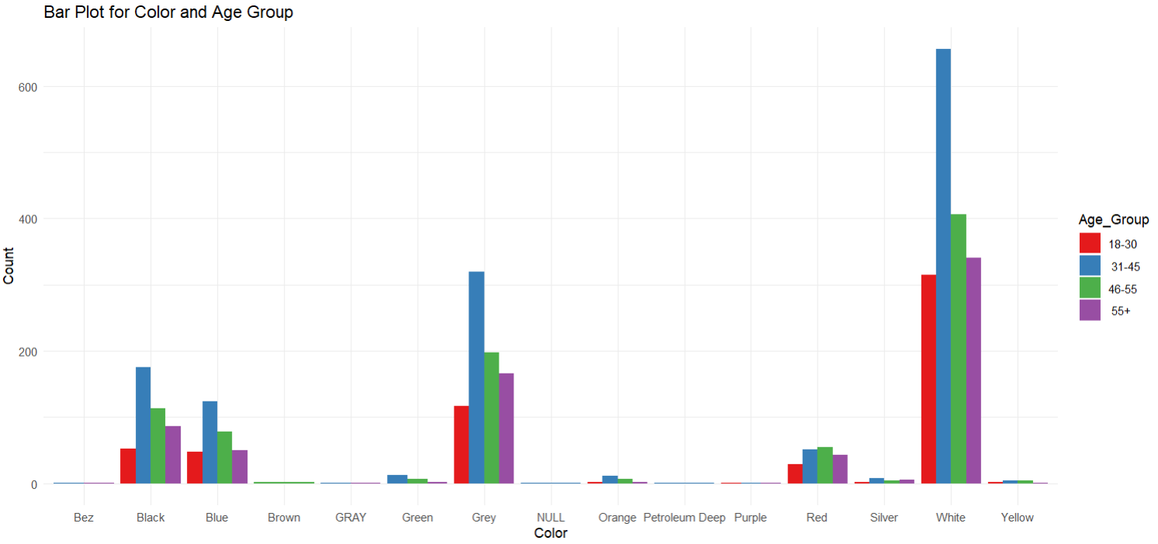
Costumers Preferences

Slide 7
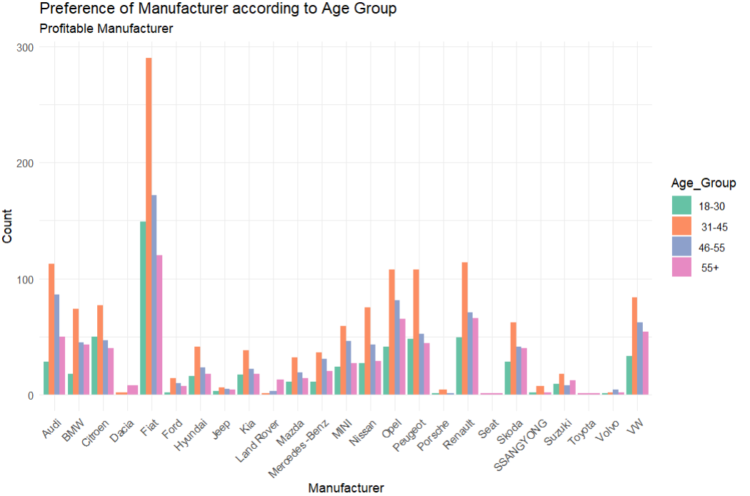
Costumers Preferences

Slide 8
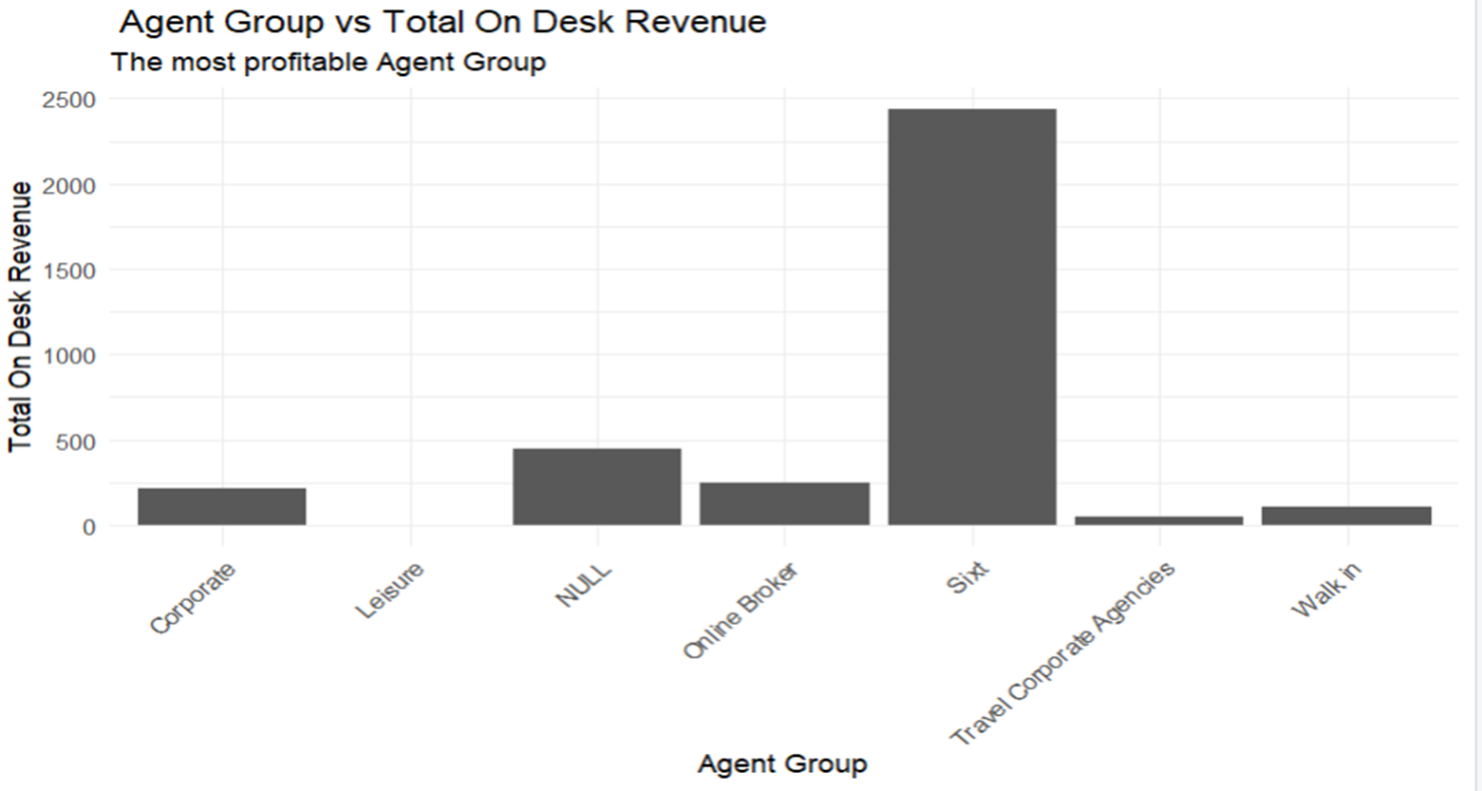
Collaboration’s contribution to Total Revenue

Slide 9

Target
Modeling
Explanatory variables selection
Predict the On Desk Net Revenue

Slide 10

On Desk Net Revenue Influence
AD -Additional Driver
BF -Loss Damage Waiver minimum
LD - Loss Damage Waiver
TG - Tyre and Windscreen Coverage
TF - Prepaid Fuel
Group
Charged Group
Rate title – Reservations cost rate category
Rental Cost Reservation
Sales Channel
Color

Slide 11
Conclusions
Revenue would increase by focusing on the costumers demands
Revenue depend to a composition of costumers preferences, collaborations and the itself policy
The average costumer is between 30 to 40 yeras old with basically known preferences
Most wanted incrementals are included to the final model

Slide 12

Thank You

